Slide 1
Main effect of Cued part, F(1,7) = 5.43, p = .053;
Main effect of Congruency, F(1,7) = 15.57, p = .006;
Interaction between Congruency and Alignment, F(1,7) = 7.70, p = .028;
Interaction between Cued part and Alignment, F(1,7) = 12.36, p = .010.

Slide 2
d prime was above chance level (zero) in all conditions.
Main effect of Cued part, Main effect of Congruency;
Interaction between Congruency and Alignment, Interaction between Cued part and Alignment

Slide 3
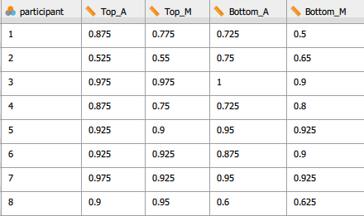
Same congruent
No effect of alignment, F(1,7) = 2.99, p = .13;
No effect of Cued part, or interaction

Slide 4
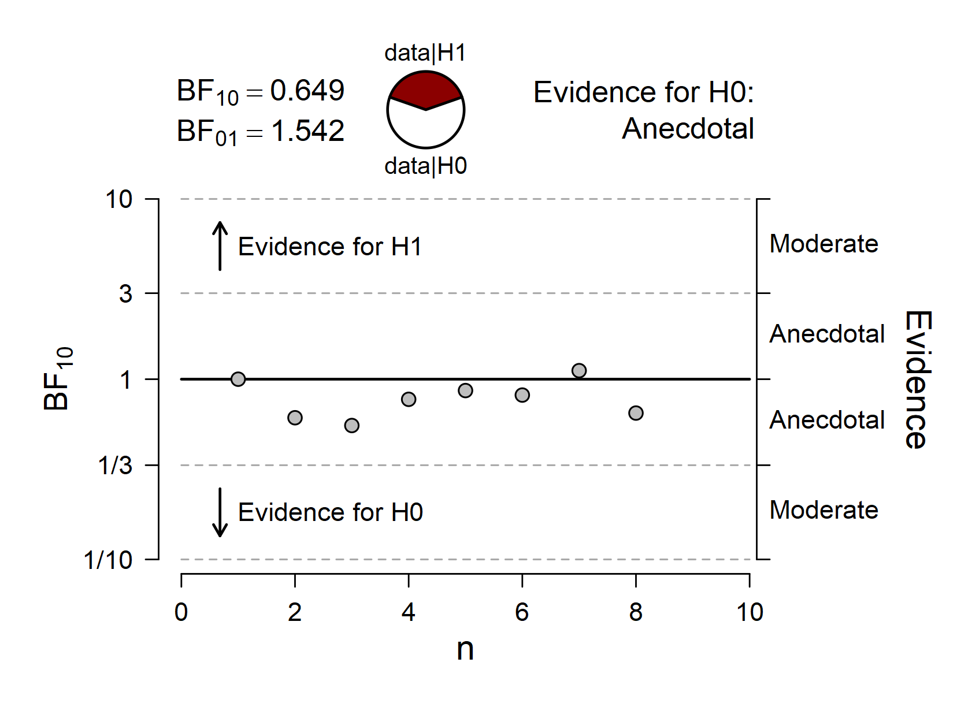
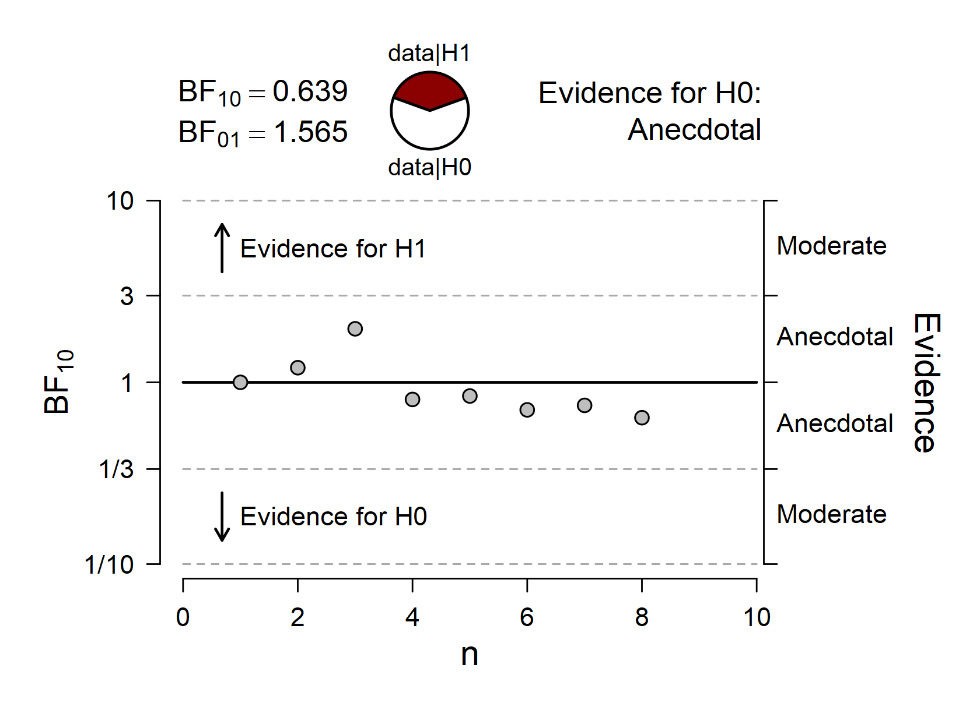
Sequential Analysis
Same congruent
Bayesian Paired Samples T-Test
 |  |  |  |  |  | BF₁₀ |  | error %
Top_A |  | - |  | Top_M |  | 0.649 |  | 0.002
Bottom_A |  | - |  | Bottom_M |  | 0.639 |  | 0.001
Top: Aligned vs. Misaligned
Bottom: Aligned vs. Misaligned

Slide 5
Same congruent

Slide 6
Aligned-Aligned
Aligned-Misaligned
Fixation 500ms
Study duration 200ms
Test duration 200ms
Response screen

